Slide 1
Ruang Bagian
Contoh Soal

Slide 2

Ruang Bagian Vektor
W subset V
W(+, *) Merupakan Ruang Bagian Vektor V terhadap +, * bila:
$∀ u, v∈W, dan skalar∝∈K berlaku$:
$u+v$ $∈W$, tertutup operasi $+$
$∝∗u∈W, tertutup perkalian skalar$

Slide 3
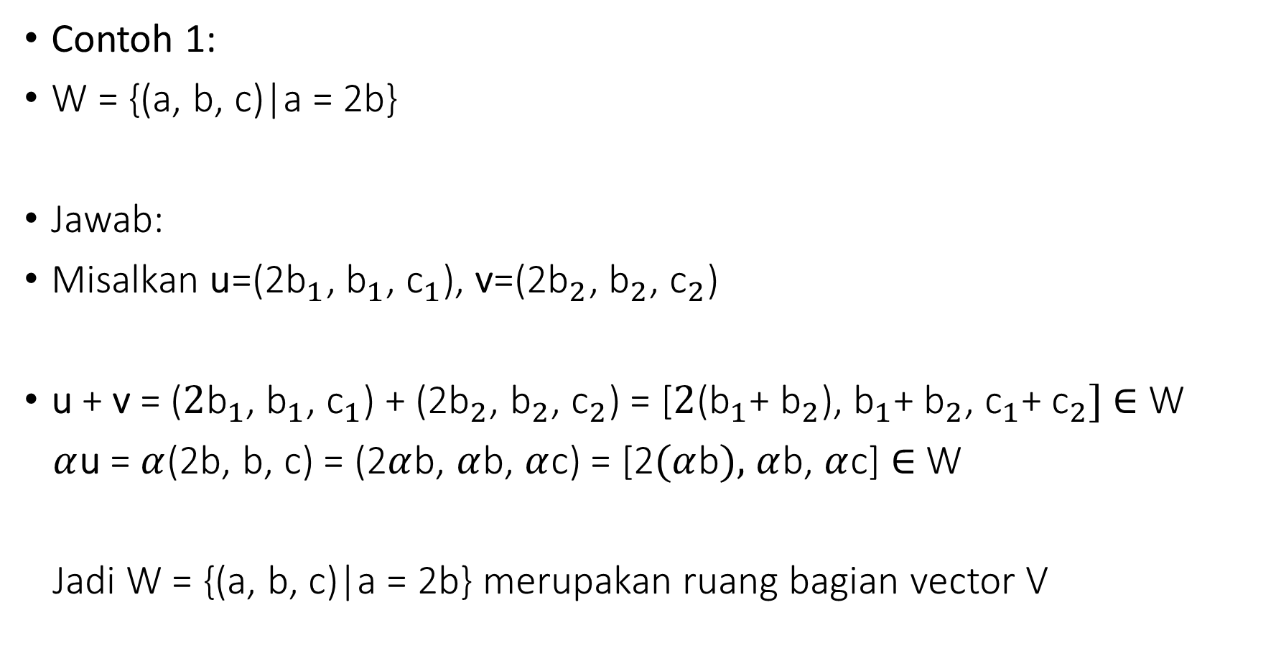
Tunjukkan bahwa W merp. Ruang Bagian Vektor dari V
Contoh 1:
W = {(a, b, c)|a = 2b}
Jawab:
Misalkan u=(${\text{2}\text{b}}_{1}$, ${\text{b}}_{1}$, ${\text{c}}_{1}$), v=(${\text{2}\text{b}}_{2}$, ${\text{b}}_{2}$, ${\text{c}}_{2}$)
u + v = ($2{\text{b}}_{1}$, ${\text{b}}_{1}$, ${\text{c}}_{1}$) + (2${\text{b}}_{2}$, ${\text{b}}_{2}$, ${\text{c}}_{2}$) = [$2{\text{(}\text{b}}_{1}$+ ${\text{b}}_{2}$), ${\text{b}}_{1}$+ ${\text{b}}_{2}$, ${\text{c}}_{1}$+ ${\text{c}}_{2}]$ $∈$ W
$α$u = $α$(2b, b, c) = (2$α$b, $α$b, $α$c) = [2$(α$b$),$ $α$b, $α$c] $∈$ W
Jadi W = {(a, b, c)|a = 2b} merupakan ruang bagian vector V

Slide 4
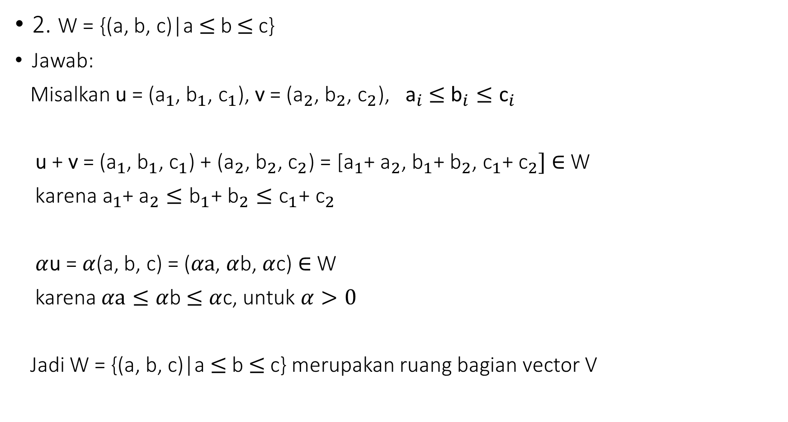
Tunjukkan bahwa W merp. Ruang Bagian dari Vektor V
2. W = {(a, b, c)|a$≤$b $≤$c}
Jawab:
Misalkan u = (${\text{a}}_{1}$, ${\text{b}}_{1}$, ${\text{c}}_{1}$), v = (${\text{a}}_{2}$, ${\text{b}}_{2}$, ${\text{c}}_{2}$), ${\text{a}}_{i}$ $≤$ ${{\text{b}}_{i}≤\text{c}}_{i}$
u + v = (${\text{a}}_{1}$, ${\text{b}}_{1}$, ${\text{c}}_{1}$) + (${\text{a}}_{2}$, ${\text{b}}_{2}$, ${\text{c}}_{2}$) = [${\text{a}}_{1}$+ ${\text{a}}_{2}$, ${\text{b}}_{1}$+ ${\text{b}}_{2}$, ${\text{c}}_{1}$+ ${\text{c}}_{2}]$ $∈$ W
${ \text{karena} \text{a}}_{1}$+ ${\text{a}}_{2}≤{\text{b}}_{1}$+ ${\text{b}}_{2}≤{\text{c}}_{1}$+ ${\text{c}}_{2}$
$α$u = $α$(a, b, c) = ($αa$, $α$b, $α$c) $∈$ W
karena $αa≤α$b $≤$ $α$c, untuk $α>0$
Jadi W = {(a, b, c)|a$≤$b $≤$c} merupakan ruang bagian vector V

Slide 5
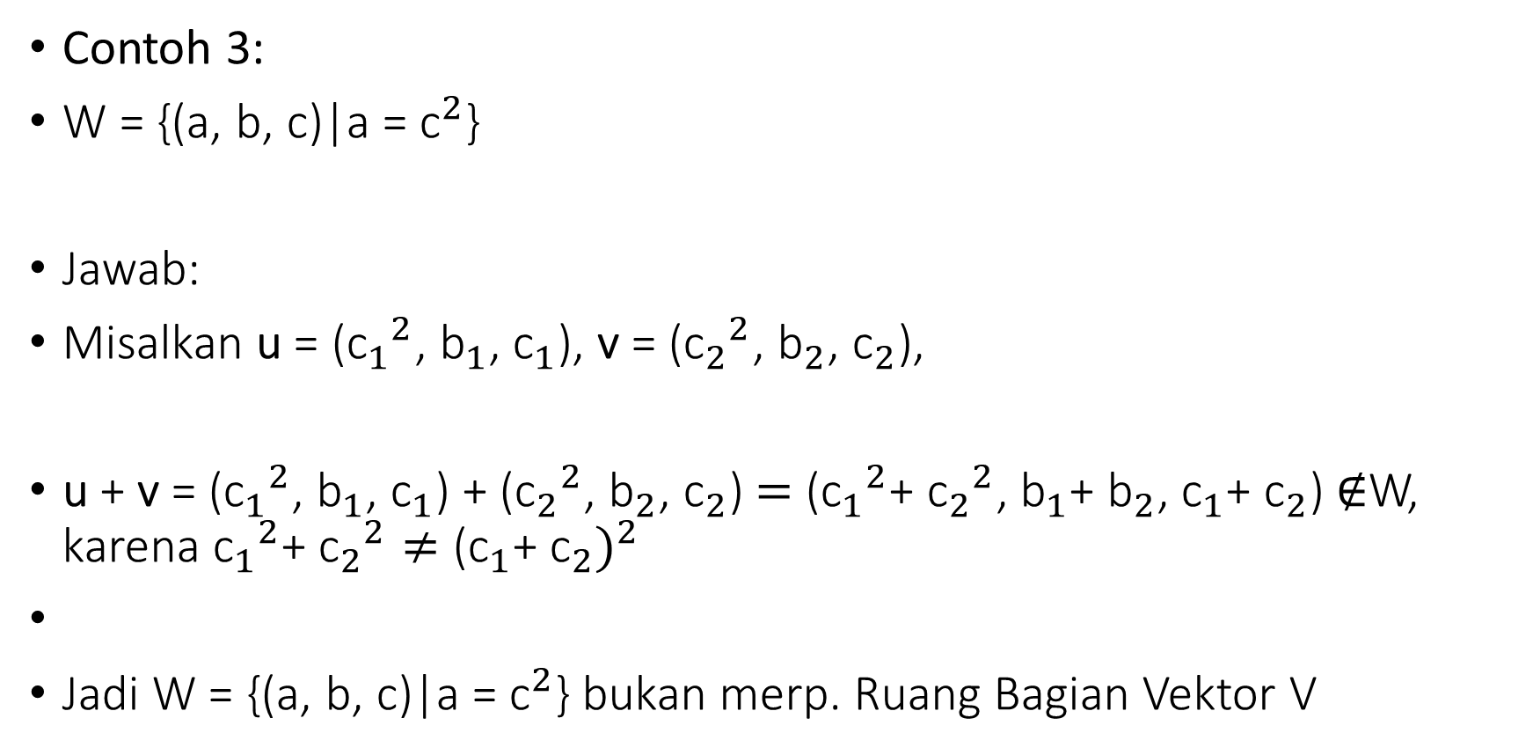
Tunjukkan bahwa W merp. Ruang Bagian dari Vektor
Contoh 3:
W = {(a, b, c)|a = ${\text{c}}^{2}$}
Jawab:
Misalkan u = (${{\text{c}}_{1}}^{2}$, ${\text{b}}_{1}$, ${\text{c}}_{1}$), v = (${{\text{c}}_{2}}^{2}$, ${\text{b}}_{2}$, ${\text{c}}_{2}$),
u + v = (${{\text{c}}_{1}}^{2}$, ${\text{b}}_{1}$, ${\text{c}}_{1}$) + (${{\text{c}}_{2}}^{2}$, ${\text{b}}_{2}$, ${\text{c}}_{2}$)$=$ (${{\text{c}}_{1}}^{2}$+ ${{\text{c}}_{2}}^{2}$, ${\text{b}}_{1}$+ ${\text{b}}_{2}$, ${\text{c}}_{1}$+ ${\text{c}}_{2}$) $∉$W, karena ${{\text{c}}_{1}}^{2}$+ ${{\text{c}}_{2}}^{2}≠$ ${{\text{(}\text{c}}_{1}\text{+ }{\text{c}}_{2})}^{2}$
Jadi W = {(a, b, c)|a = ${\text{c}}^{2}$} bukan merp. Ruang Bagian Vektor V

Slide 6
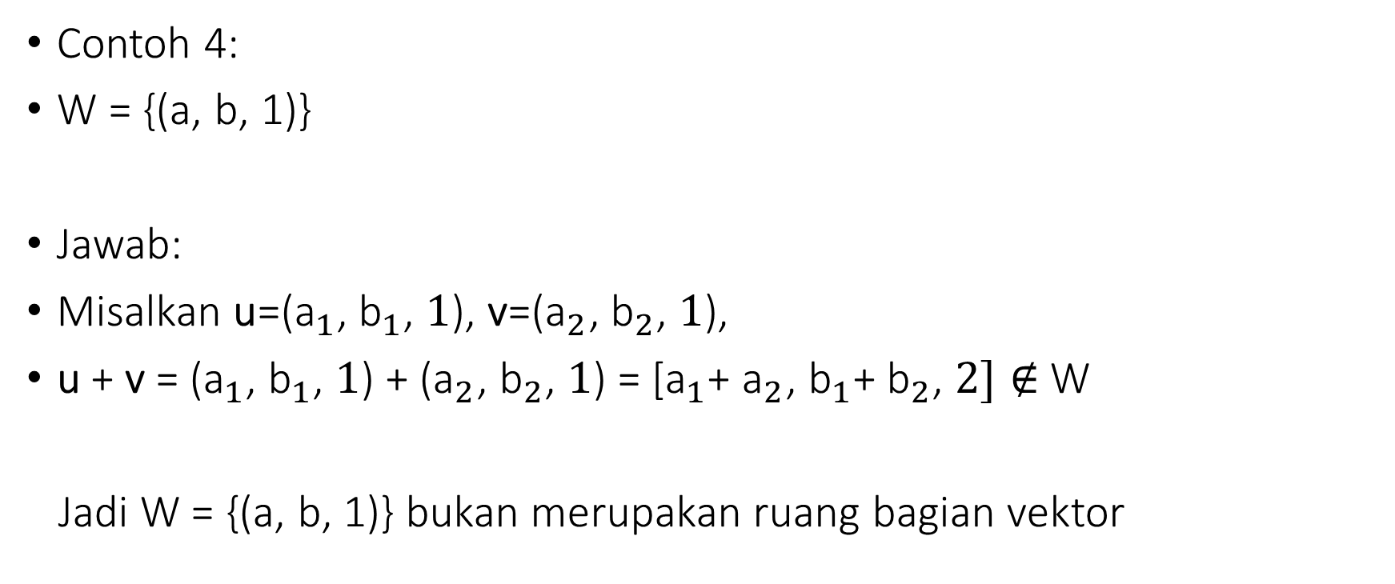
Tunjukkan bahwa W merp. Ruang Bagian dari Vektor V
Contoh 4:
W = {(a, b, 1)}
Jawab:
Misalkan u=(${\text{a}}_{1}$, ${\text{b}}_{1}$, $1$), v=(${\text{a}}_{2}$, ${\text{b}}_{2}$, $1$),
u + v = (${\text{a}}_{1}$, ${\text{b}}_{1}$, $1$) + (${\text{a}}_{2}$, ${\text{b}}_{2}$, $1$) = [${\text{a}}_{1}$+ ${\text{a}}_{2}$, ${\text{b}}_{1}$+ ${\text{b}}_{2}$, $2]∉$ W
Jadi W = {(a, b, 1)} bukan merupakan ruang bagian vektor

